Slide 1
Online Retail Sales DB
Python based MySQL Project
By- Nisit Kumar Mohanty
Email- mnisitkumar@gmail.com
Github- https://github.com/november17mike

Slide 2
Key Features
Database-driven architecture using MySQL
Realistic data generation using Faker
Data Visualizations using Matplotlib & Seaborn
Location Filter with default: Bhubaneswar
Interactive menu-driven reports

Slide 3
Tools Used:
Python - Frontend Application
MySQL - Backend Database
SQLAlchemy - Python to MySQL Connector
Faker - Dummy Data Generator
Pandas - Data Handling
Matplotlib/Seaborn - Visualization

Slide 4
Database Schema
1. Customers
2. Products
3. Orders
4. Order_Items
Linked via Foreign Keys (Normalized Relational Structure)

Slide 5
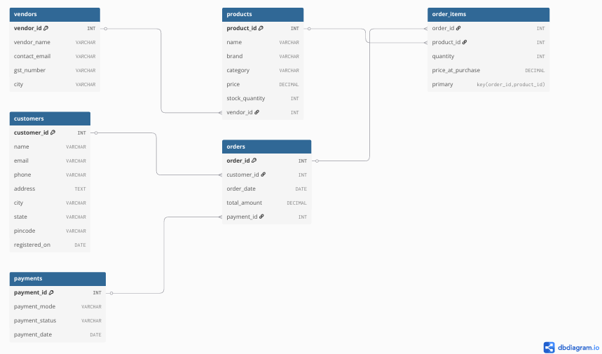
ER Diagram

Slide 6
Reports Offered
Top 10 Customers
Monthly Sales Trends
Product-wise Sales
City-wise Sales
User may exit anytime or run it accordingly

Slide 7
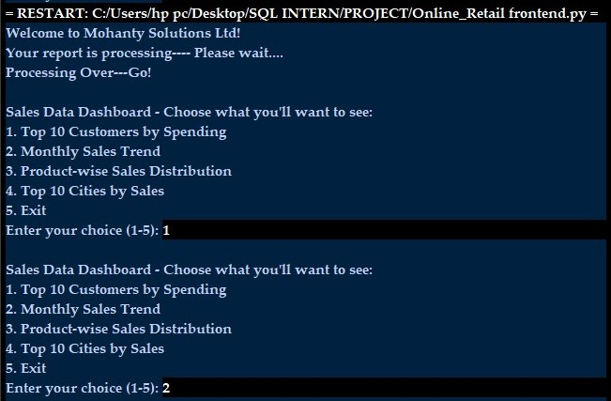
Sample Display:

Slide 8
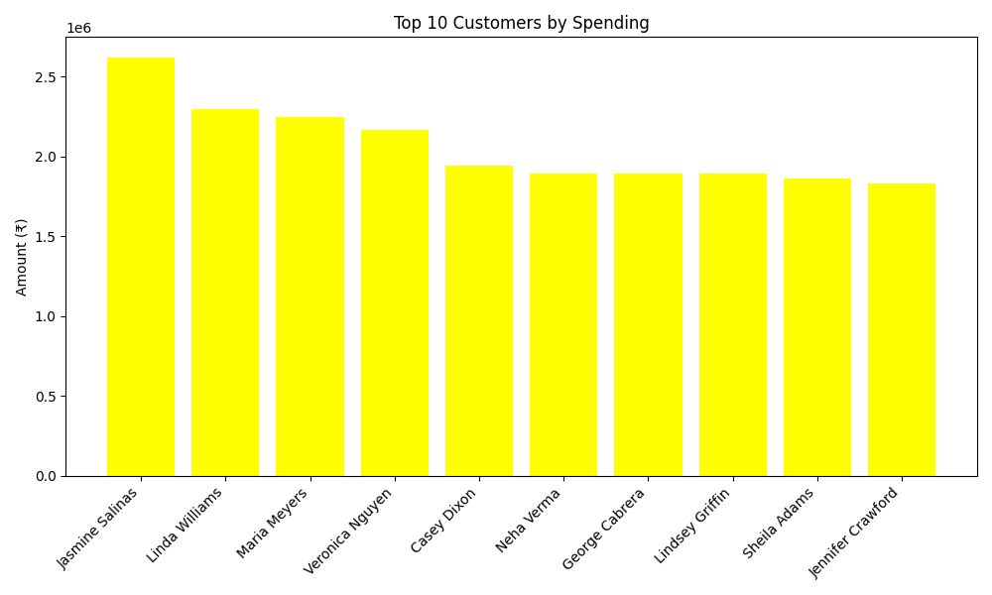
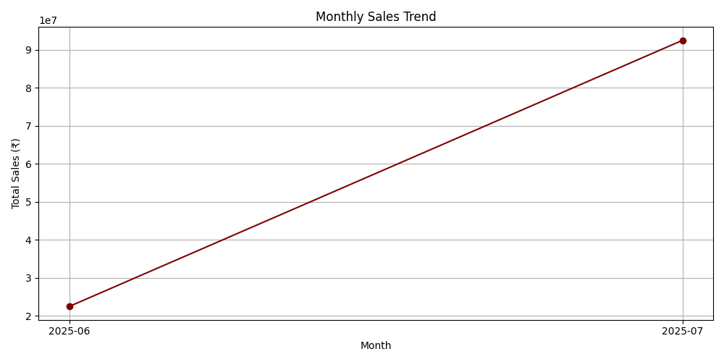
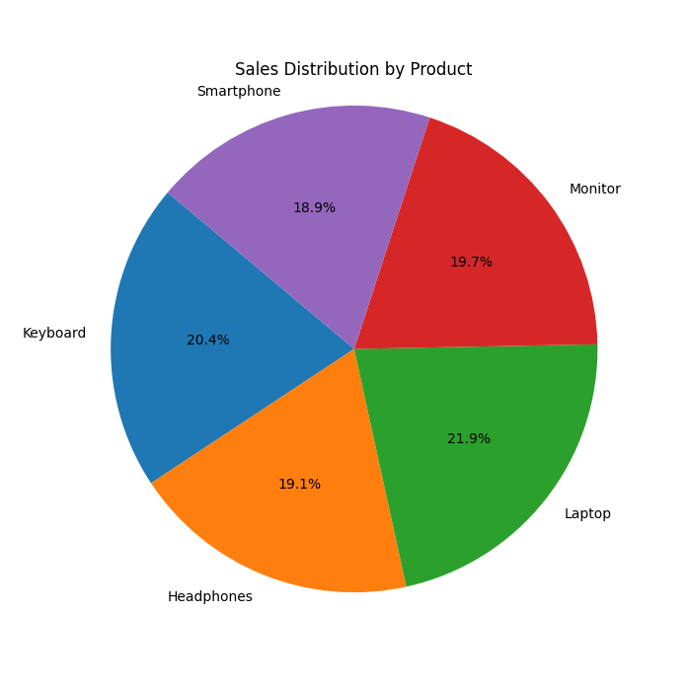
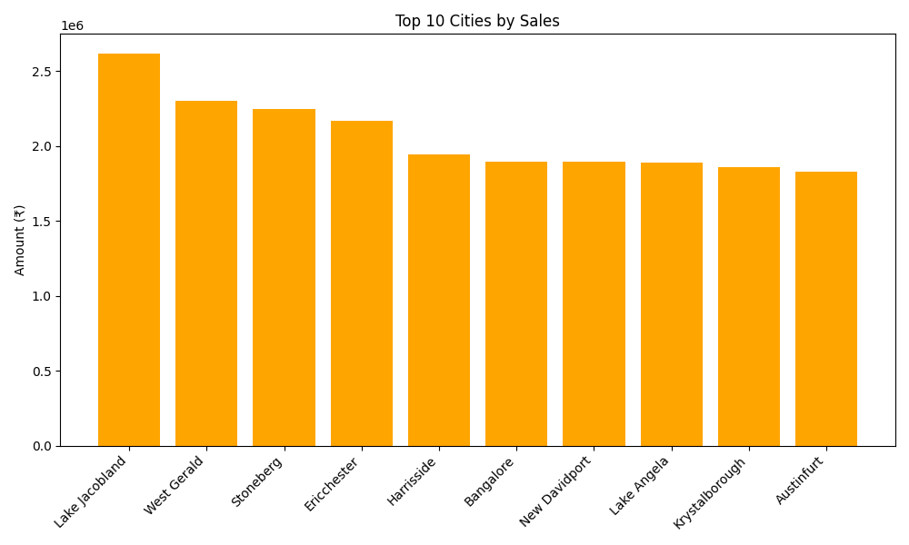
Output Generated:

Slide 9
Future Scope
Add web frontend using Flask
Export to PDF/Excel reports
Drill-down analytics for customers
Real-time live dashboards

